Slide 2
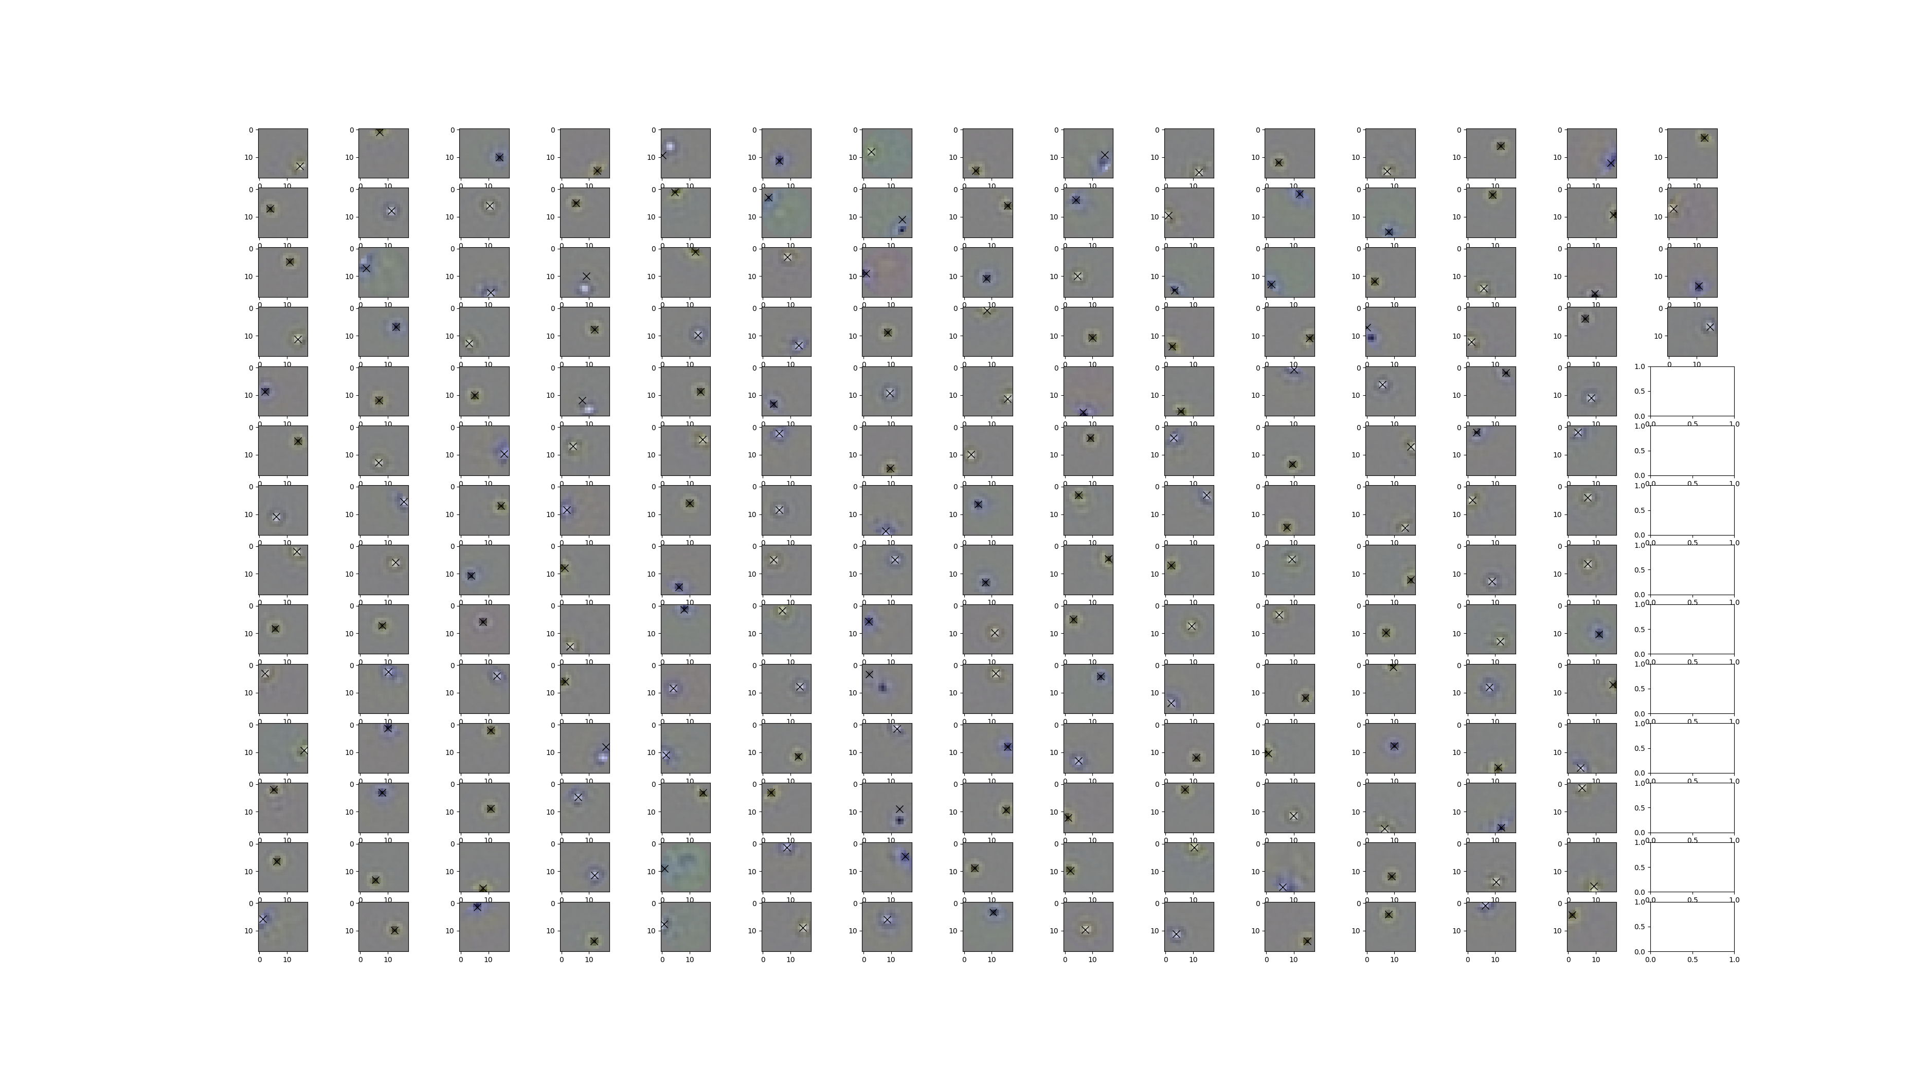
Previous algorithm to detect centers – good but some misses at 200 RGCs

Slide 3
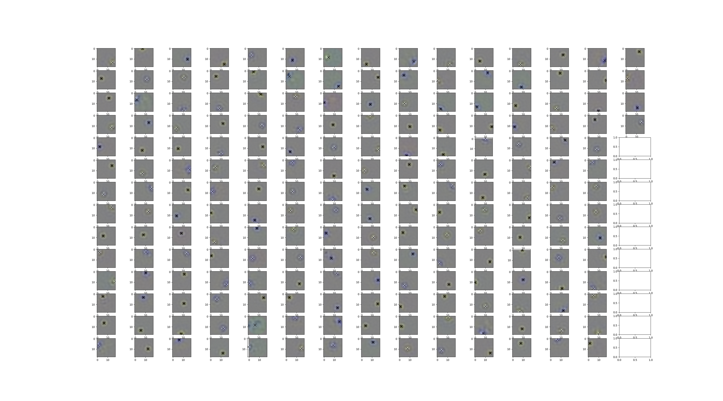
Gaussian fit to estimate centers – more reliable

Slide 4
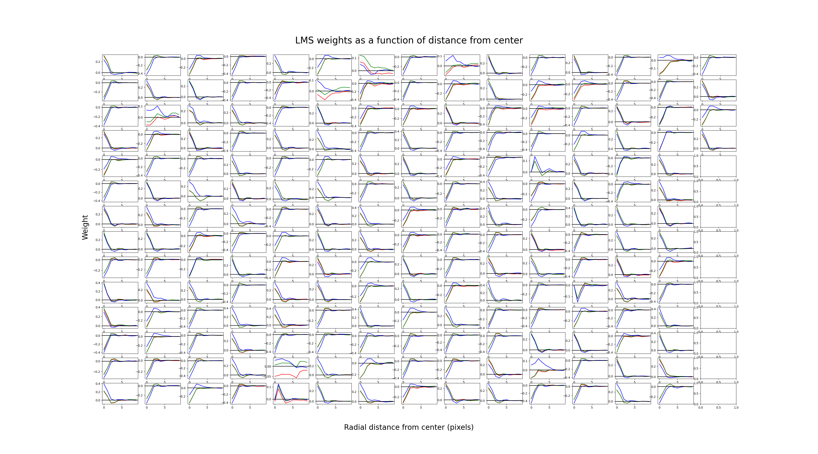
Centers are luminance-based, but surrounds can be either 1 cone or many

Slide 5
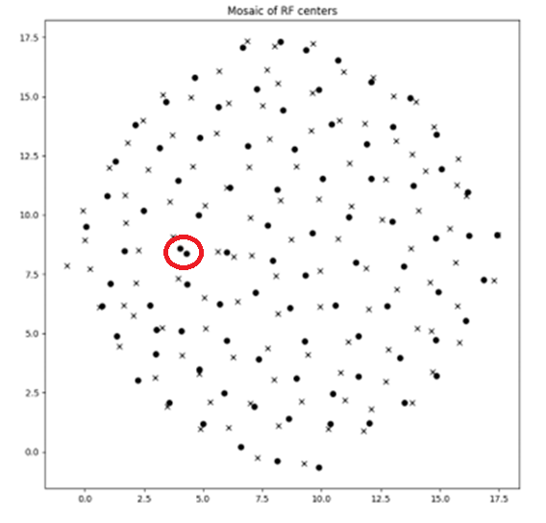
Updated mosaic with 200 RGCs
# 65 and 84 are both On-center with same location

Slide 6
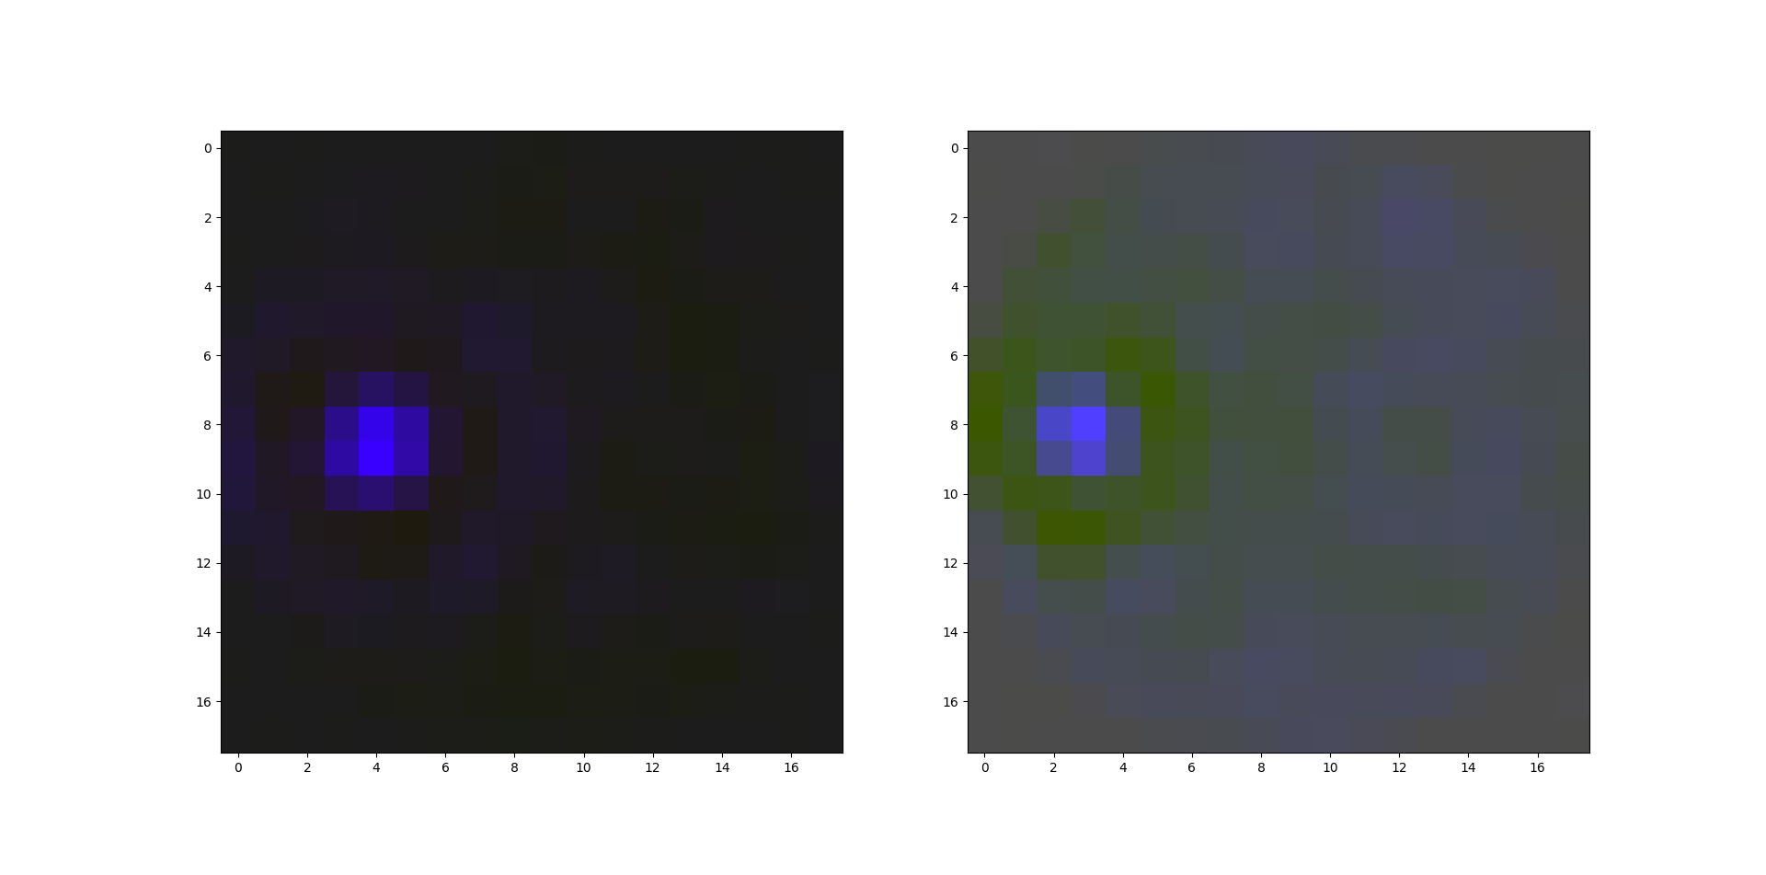
What are these two RFs right next to each other?

Slide 7
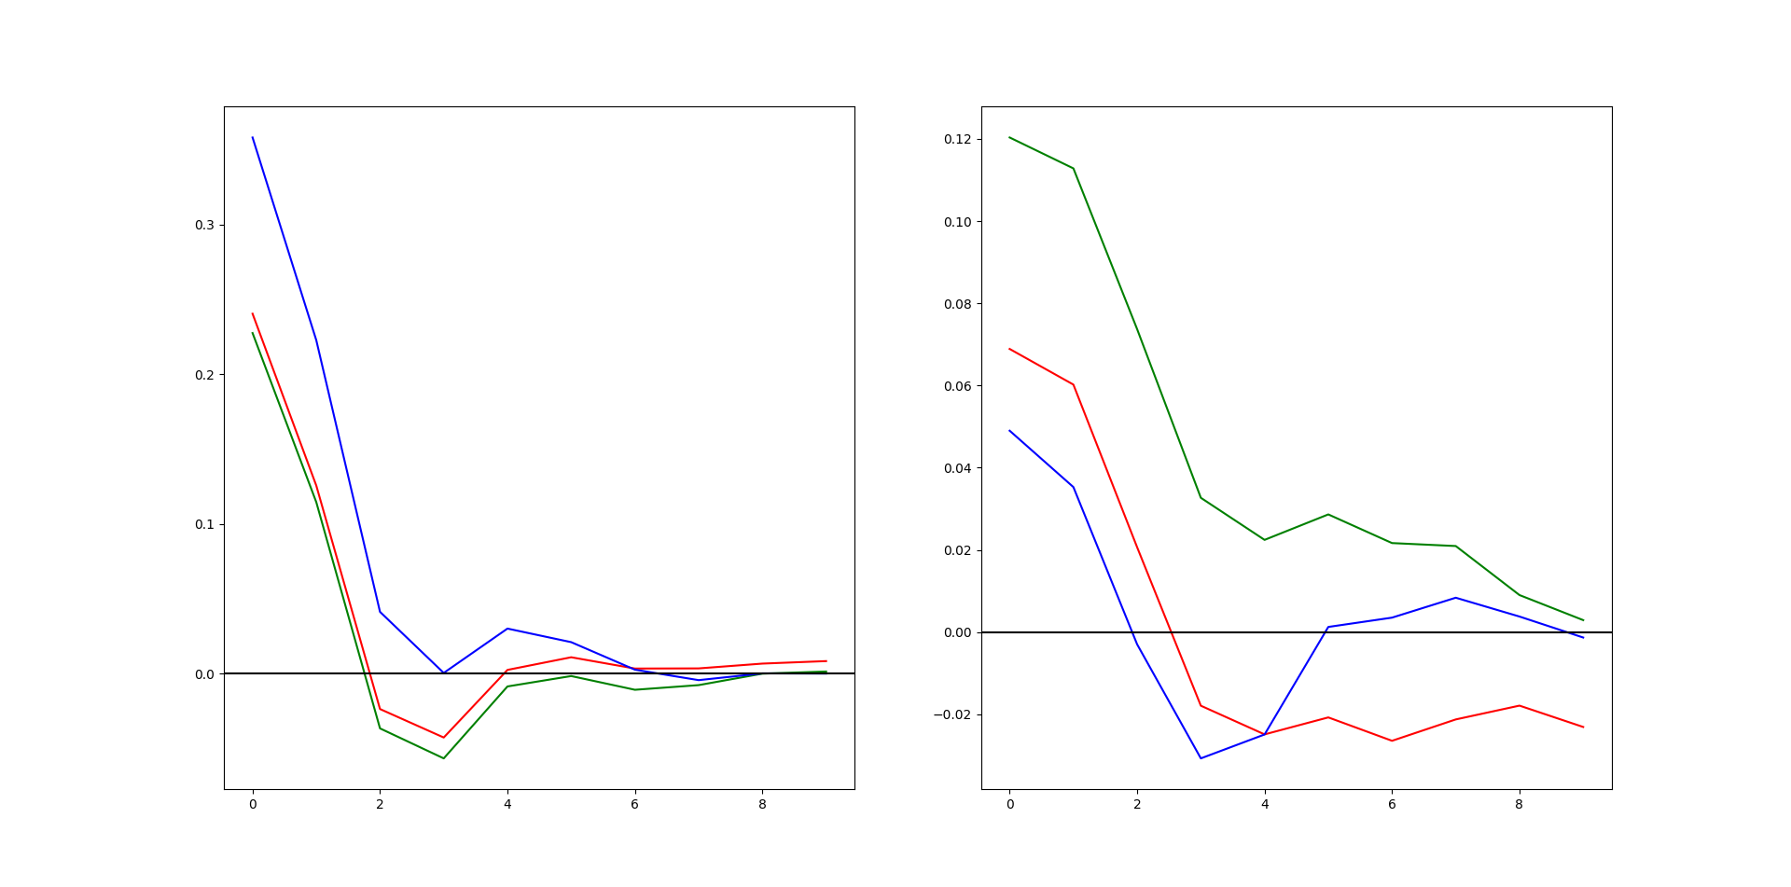
What are the centers and surrounds like?

Slide 8
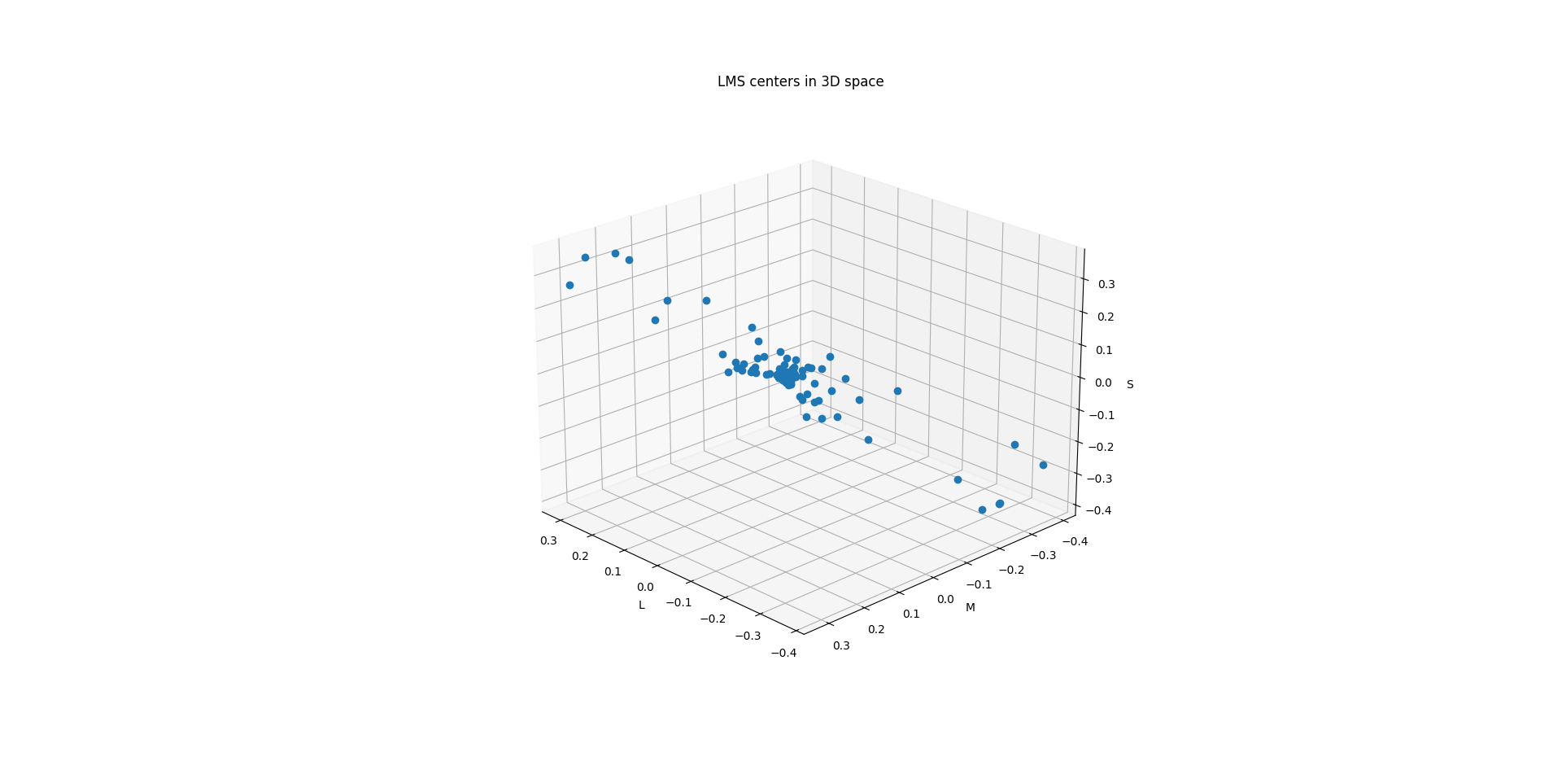

Slide 9
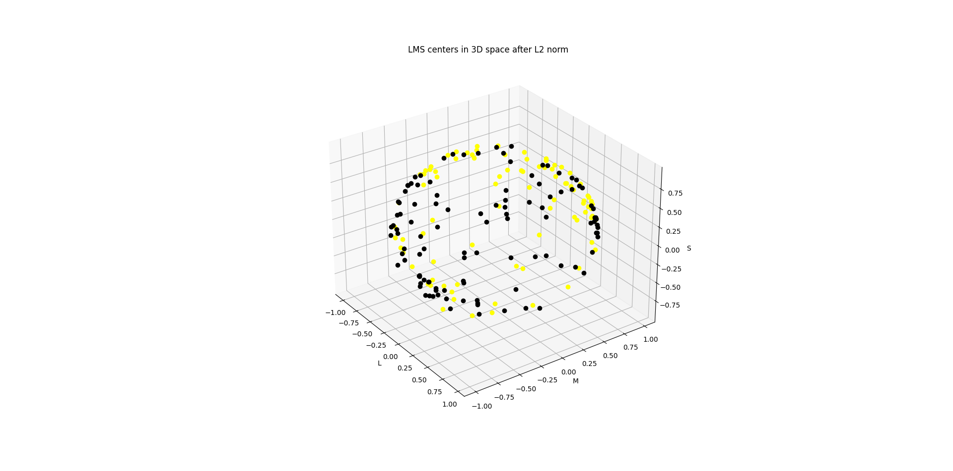

Slide 10
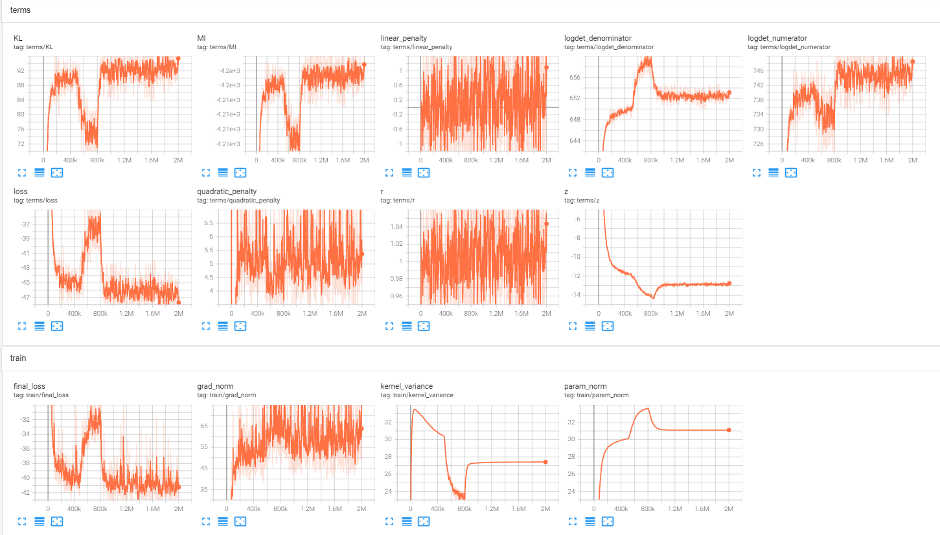

Slide 11
